Slide 1

Find the Number of Followers From Twitter
A end to end solution report submitted for the fulfilment of completing a Mini Project in the area
Artificial Intelligence and Machine Learning
Dept of
COMPUTER SCIENCE ENGINEERING
by
Bharathi D(20JG1A4216)
Anjali K(20JG1A4225)
Praseeda S(20JG1A4247)
Under the guidance of
Dr. L Greeshma
(Assistant Professor)
Department of CSE
GAYATRI VIDYA PARISHAD COLLEGE OF ENGINEERING FOR WOMEN
(Affiliated to Jawaharlal Nehru Technological University Kakinada)
Madhurwada, Vishakhapatnam

Slide 2

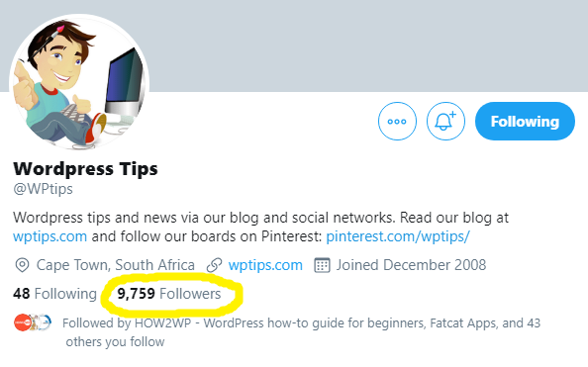

Team Follow-Up
Presents
An End-to-End Solution to
Find the Number of Followers From Twitter

Slide 3

Setting the Scene
Twitter shows how many followers an account has on their Profile page.
If the number is 10,000 or more, it rounds it to the nearest one hundred.
For example here is @WPtips with 9,759
To get the number of followers from any given Twitter account, we first need to convert the account name to id, which can be done so by following this link:
https://codeofaninja.com/tools/find-twitter-id/#:~:text=Put%20your%20username%20(without%20%40%20sign,appear%20in%20the%20green%20box

Slide 4
Enabling Developer Account
Log-in to Twitter and verify your email address and phone number
Go sign up at developer.twitter.com with your basic name, location and use case details
Review and accept the developer agreement
You should now have access to the Developer Portal to create a new App and Project with Essential access
To check if you have a developer account go to the developer portal dashboard to review your account status and setup.

Slide 5
What is the developer portal?
The developer portal is a self-serve user interface within developer.twitter.com where developers can manage their API access through Projects, and Apps
The developer portal is visible when a user is logged in (with Twitter) and has a developer account on developer.twitter.com.
You can access the developer portal by clicking the "Developer Portal" link in the top right-hand corner of developer.twitter.com.

Slide 6
Different access levels to the Twitter API
All Twitter API access requires a developers account, which can be created quickly by signing up. Essential access will be available immediately, and Elevated access can be requested.
Essential: Free, instant access to the Twitter API. Includes 500k Tweets/month and a single App environment. 1 App, 1 Project.
Elevated: Free access up to 2M Tweets/month, and 3 App environments.
3 Apps, 1 Project. Requires an approved developer account application.

Slide 7
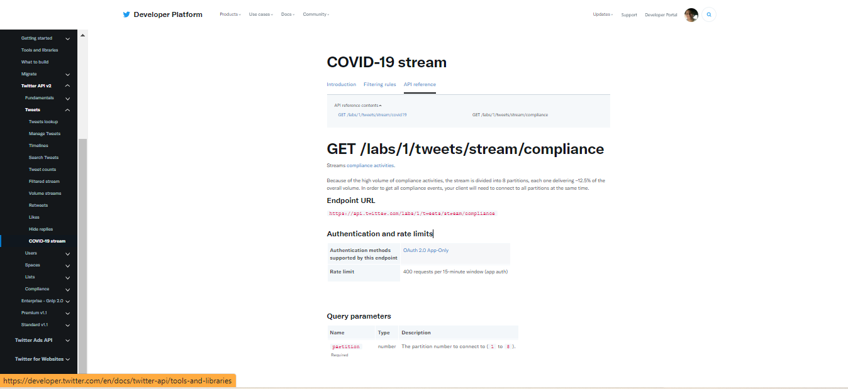
A Sample of API Reference Index

Slide 8
Generating Twitter API Keys
1. This key allows you to make authorized requests for data.
Each API key can only be used for one app.
2. Go to https://apps.twitter.com/ and log in using your twitter account. If you don't have a Twitter account, create one at https://twitter.com/signup
3. Fill in the "Create an application" form, enter the CAPTCHA at the bottom (if applicable), and click on "Create your Twitter application."
Use the information under your app's "Publish" tab to complete this form.

Slide 9

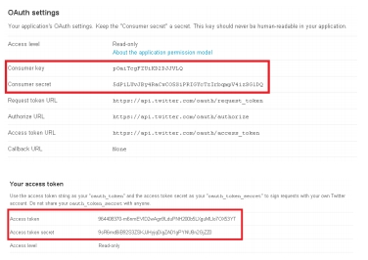
Generating Twitter API Keys (contd..)
4. Click on "Create my access token" to generate your token. You may have to refresh your browser if it doesn't appear after a while.
5. Copy the following keys from your Twitter
app
- Consumer key
- Consumer secret
- Access token
- Access token secret

Slide 10
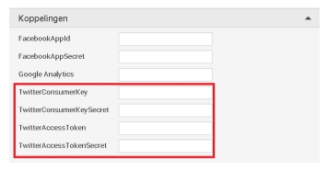
Generating Twitter API Keys (contd..)
6. Go to http://design.appmachine.com and log into your AppMachine account.
Select the app you want to publish and got to the "Publish" tab.
Towards the bottom of the screen you'll see the "Advanced" section.
Click on "Twitter" and you'll find the fields to enter your data. Enter your newly acquired Twitter details here
7. Make sure you save these details once you've entered them.

Slide 11
Generating Twitter API Keys (contd..)
6. Go to http://design.appmachine.com and log into your AppMachine account.
Select the app you want to publish and got to the "Publish" tab.
Towards the bottom of the screen you'll see the "Advanced" section.
Click on "Twitter" and you'll find the fields to enter your data. Enter your newly acquired Twitter details here
7. Make sure you save these details once you've entered them.

Slide 12
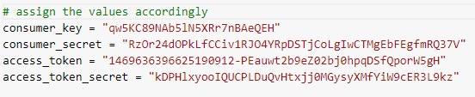

Our Source Code
1.
Tweepy is an open source Python package that gives you a very convenient way to access the Twitter API with Python
2.
Assign your Twitter generated keys to enable your Twitter API account
3.
OAuthHandler is an open-standard authorization protocol or framework that provides applications the ability for “secure designated access.”

Slide 13

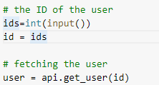

Our Source Code (contd..)
4.
Tweepy.api→Connects to the twitter Restful API to access twitter data with Python
5.
Getting input from the user of the ids.
api.get_user→ gets the current username
6.
Fetching the followers number and displaying the output

Slide 14
Our Output
Id of a particular account is to be given by the user. And the conversion of an account name to its respective twitter id can be done through:
https://codeofaninja.com/tools/find-twitter-id/#:~:text=Put%20your%20username%20(without%20%40%20sign,appear%20in%20the%20green%20box
The link to the entire source code and demonstration of the working can be found in our Colab file:
https://colab.research.google.com/drive/1urrIfxtridDSsqXgaazjr3Zr44D_Uhj1?usp=sharing

Slide 15

Our ML Certifications..
Bharathi D (20JG1A4216)

Slide 16

Our ML Certifications..
Anjali K
(20JG1A4225)

Slide 17

Our ML Certifications..
Praseeda S
(20JG1A4247)

Slide 18
Team
Name and Roll | Department | Profile
Bharathi Dhereddy (20JG1A4216) | Department of Computer Science (Artificial Intelligence and Machine Leaning) GVP College of Engineering for Women | LinkedIn(https://www.linkedin.com/in/bharathi-dhereddy-0b4a05222/)
Anjali Kakarlapudi (20JG1A4225) |  | LinkedIn(https://www.linkedin.com/in/anjali-kakarlapudi-8bba23219/)
Praseeda Saripalle (20JG1A4247) |  | LinkedIn(https://www.linkedin.com/in/praseeda-saripalle-a44a03208/) GitHub(https://github.com/PraseedaSaripalle) Hackerearth(https://www.hackerearth.com/@praseeda.saripalle)

